Slide 1


VITAL DISPATCH PRO
Finite Amount of Ambulences Distribution System
Name of Project:
Presented By:
Presented To:
VitalDispatch Pro
Bit Waves
HACKATHON 2023

Slide 2

01 | Problem Overview
02 | Solution Overview
03 | Demonstration
04 | Expandabiliuty
Agenda.
02

Slide 3
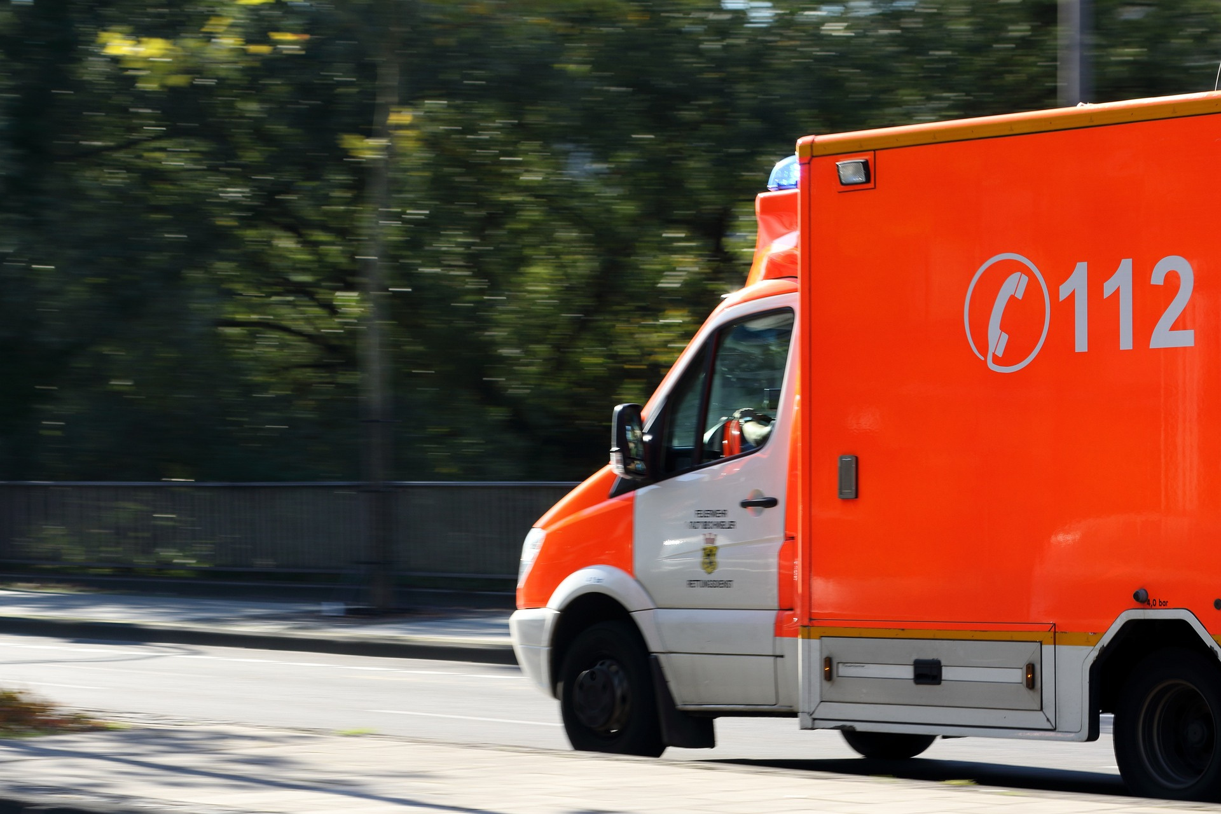

Problem
Overview.
In resource-limited settings like ours, the availability of services such as ambulance service is finite.
Existing dispatch systems suffer from delayed response times.
03

Slide 4
OUR SOLUTION
Solution 1
Solution 2
Changing the locations
to improve quality.
Change allocated number
of ambulances
for predefined locations
04

Slide 5


SOLUTION 1
Why we aren't using this.....
Practically Imposible....
Locations won't be available
Expensive investment
05

Slide 6
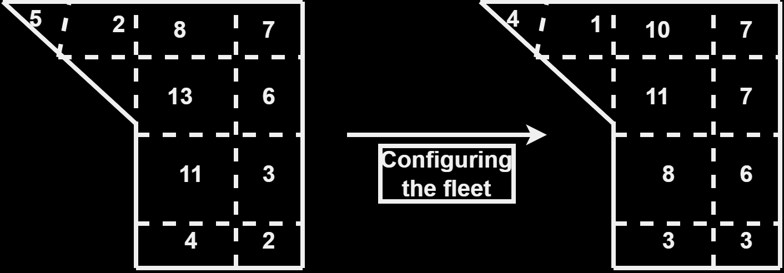
SOLUTION 2

Slide 7
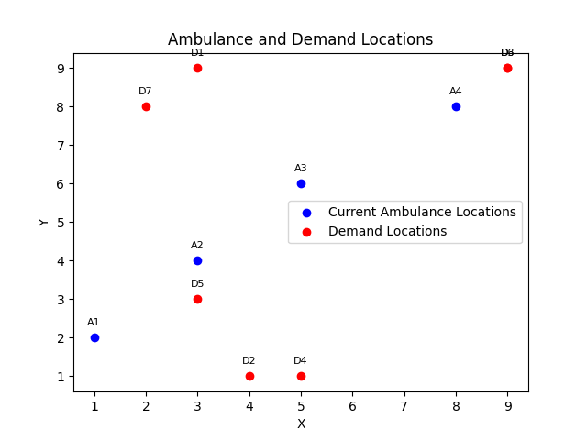
How our system works ?
What are demand locations ?
Let's proceed to the demonstration

Slide 8
EXPANDABILITY OF CURRENT SOFTWARE
Integrating Google maps Api...
Real time data analysis...
Improved mathematical model...

Slide 9


EXPANDABILITY
Fire department firetruck allocation
Police department troops allocation
War troops allocation
An efficient taxi services

Slide 10
Thank you !

